Slide 1



Journey PPT
Tanishqa Aggarwal
26 Sep 2023 - 29 Sep 2023
Week 6

Slide 2

Day 1
26 Sep 2023
Databricks
Databricks is a unified analytics platform designed for big data and machine learning. It simplifies the process of building, managing, and deploying data and machine learning pipelines at scale. Databricks provides a collaborative workspace for data engineers, data scientists, and machine learning engineers to work together on projects involving large datasets and advanced analytics.

Slide 3
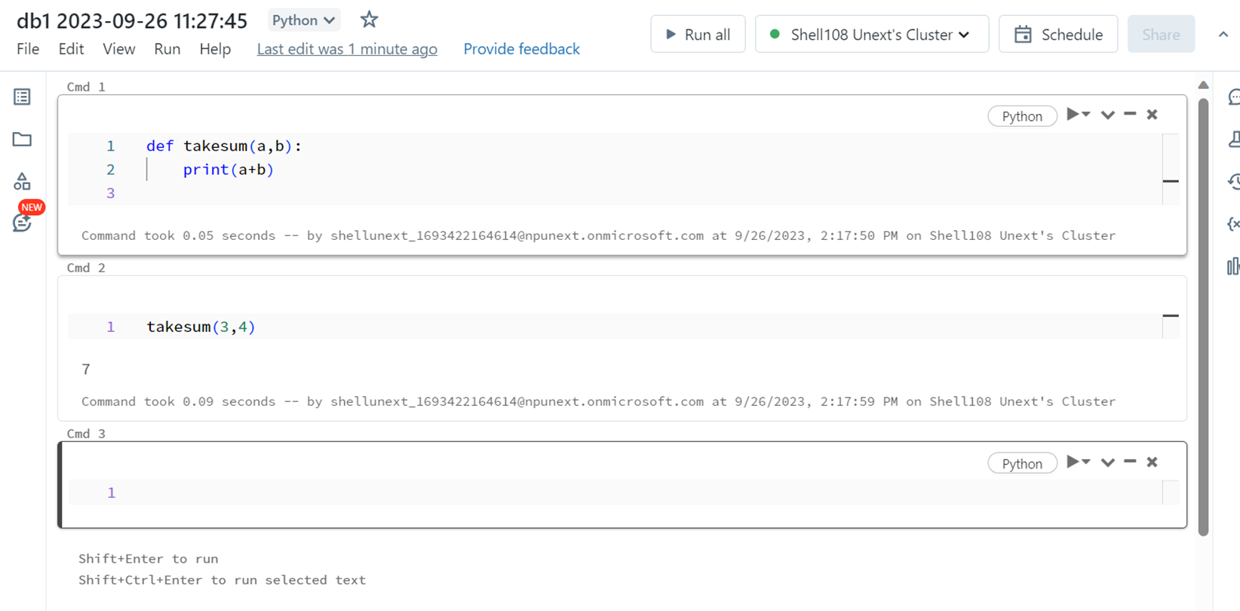
Day 1
26 Sep 2023
Databricks
Connecting notebook to cluster

Slide 4
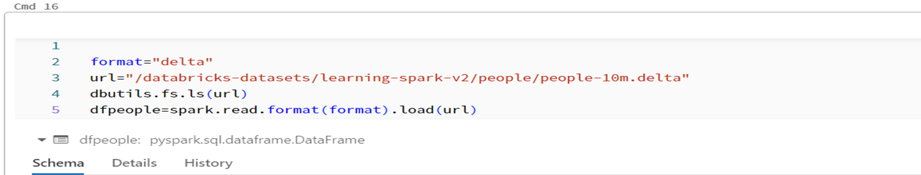
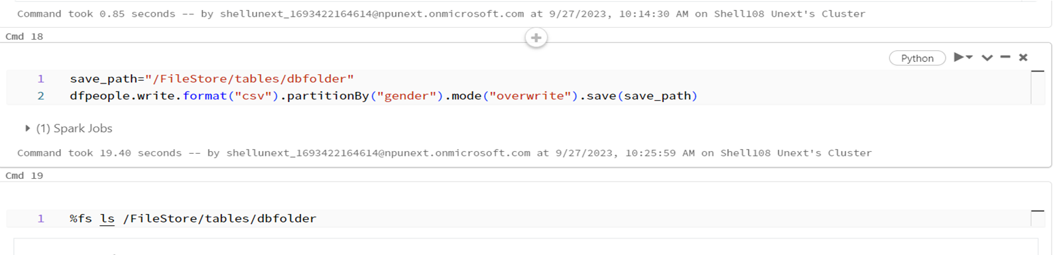
Day 1
26 Sep 2023
Databricks
Generating partitions

Slide 5
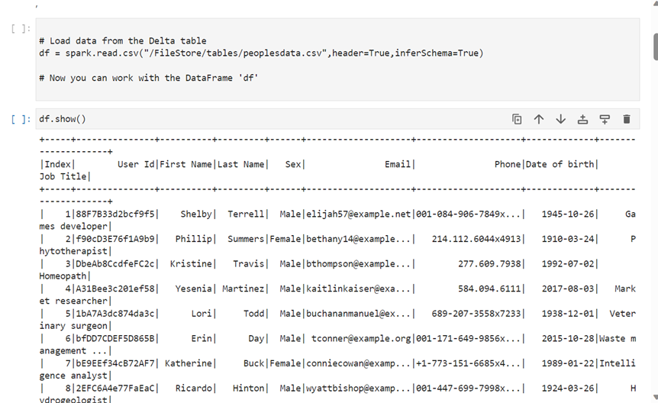
Day 2
27 Sep 2023
Databricks (part 2)
Loading data to azure notebook

Slide 6
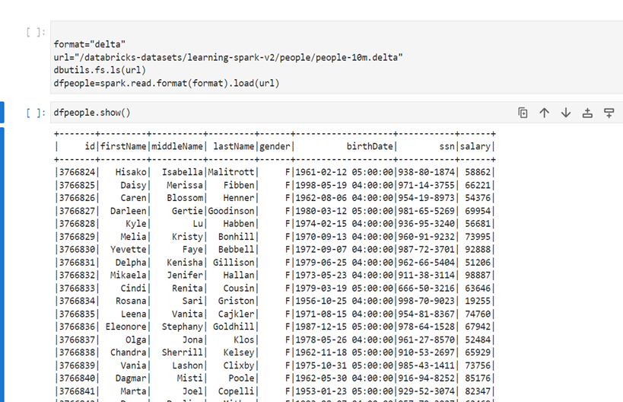
Day 2
26 Sep 2023
Databricks (part 2)
Loading data to azure notebook

Slide 7
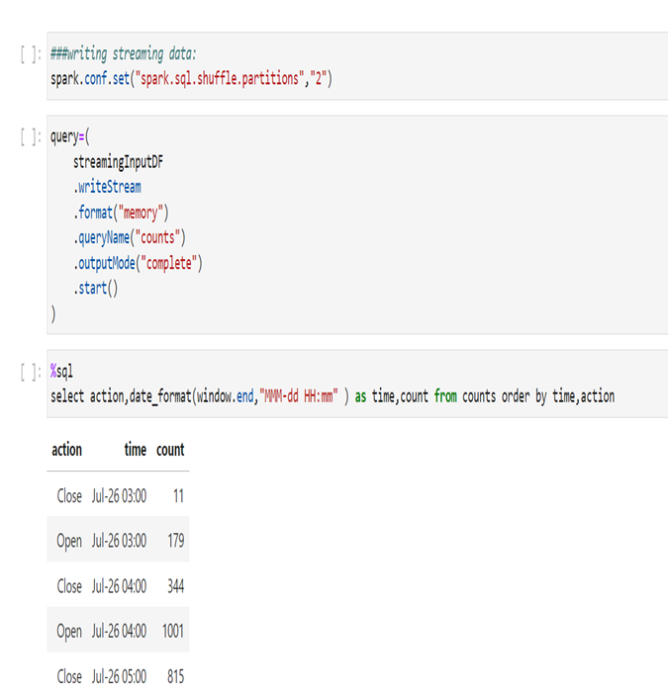
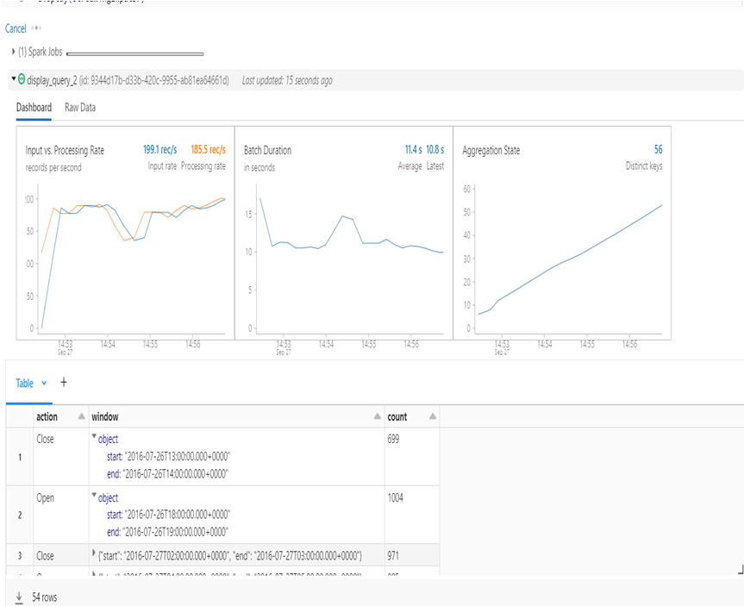
Day 2
26 Sep 2023
Databricks (part 2)
Data Streaming

Slide 8
Day 3
28 Sep 2023
Docker
Docker is an open-source platform designed to simplify the development, deployment, and management of applications by using containerization technology. Containers are lightweight, portable, and self-sufficient units that can package an application and its dependencies, ensuring consistency and reproducibility across different environments. Docker has become immensely popular in the world of software development and deployment.

Slide 9
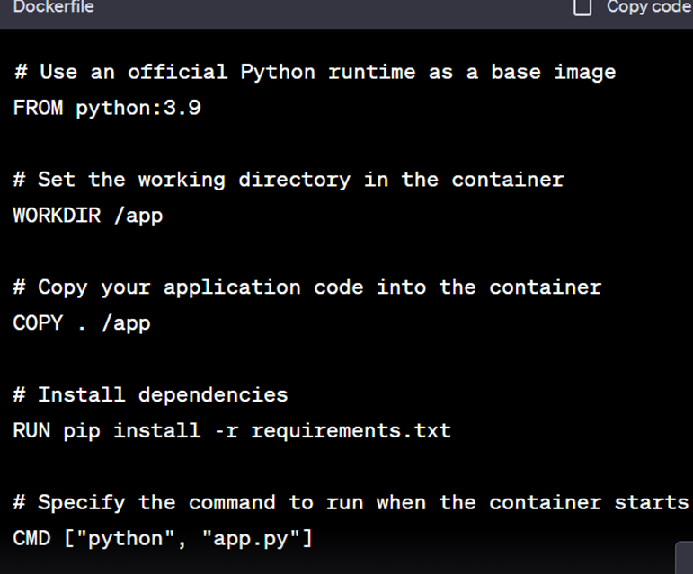
Day 3
28 Sep 2023
Docker
Sample dockerfile

Slide 10
Day 4
29 Sep 2023
Docker (part 2)
Running a Docker file
Basic Run
Detached Mode
Mapping Ports
Docker run your-image-name:tag
If you want to run the container in the background and free up your terminal, you can use the -d flag like this:
docker run -d your-image-name:tag
If your containerized application listens on specific ports, you can map those ports to your host machine using the -p flag. Ex:
docker run -d -p 8080:80 your-image-name:tag

Slide 11



Day 4
29 Sep 2023
Docker (part 2)
Entering a container
docker exec -it container_id_or_name /bin/bash
Using the above command we can execute bash commands
-it: These flags are used to run the command interactively and allocate a pseudo-TTY.
By going inside the container
container_id_or_name: Replace this with the ID or name of the running container you want to enter.
•/bin/bash: This specifies the shell or command you want to run inside the container. In this example, it's set to /bin/bash, which is a common shell. You can replace it with another shell or command if needed.

Slide 12

Thank You

